Slide 1
Bayesian cognitive and statistical modeling applied to Signal Detection Theory and the Mirror Effect in a perceptual task

Slide 2
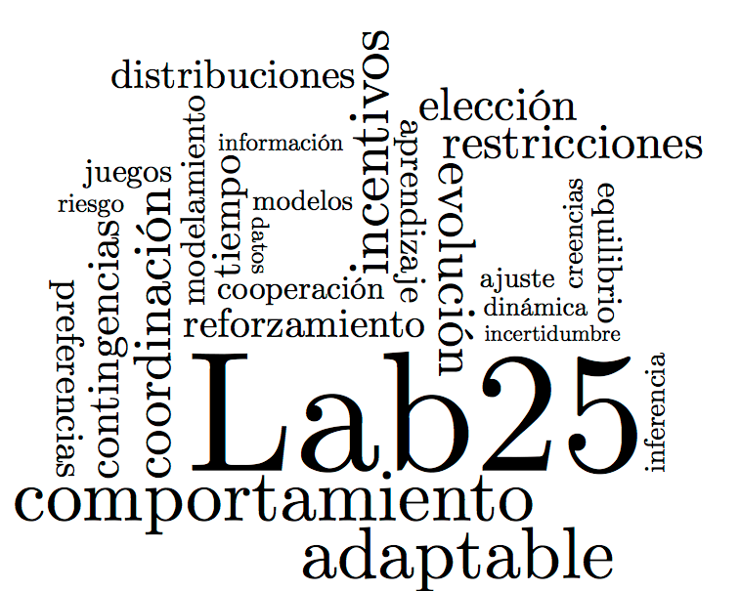
Introduction
A description of what
we wanted to study.

Slide 3
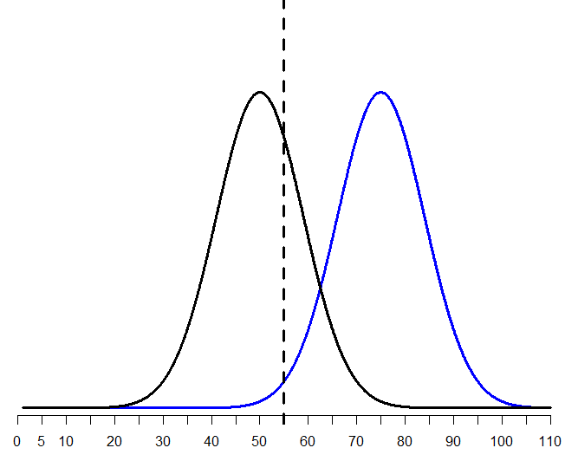
Signal Detection Theory

Slide 4
Signal Detection Theory
Originally developed within the engineering framework
SDT is a statistical model which has proven to be very useful as a cognitive model too.
It’s been widely applied to different domains within Psychology

Slide 5
Recognition Memory
Study Phase
Can be presented as…
Intentional (participants are asked to memorize/study the stimuli)
Incidental (participants are told to interact with the stimuli)
Recognition task
“Was this particular stimulus a part of the set of stimuli previously presented?”

Slide 6
The Mirror Effect
“If there are two classes of stimuli, and one is more accurately recogized than the other, then the superior class is both more accurately recognized as old when old and also more accurately recognized as new when new (…) means that the greater efficiency in recognizing is always twofold”
(Glanzer, Adams, 1990)

Slide 7
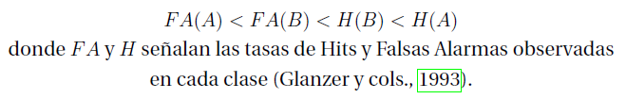
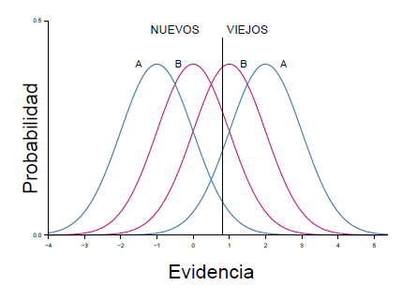
Binary Tasks (Yes/No)

Slide 8
Binary Tasks (Yes/No)

Slide 9
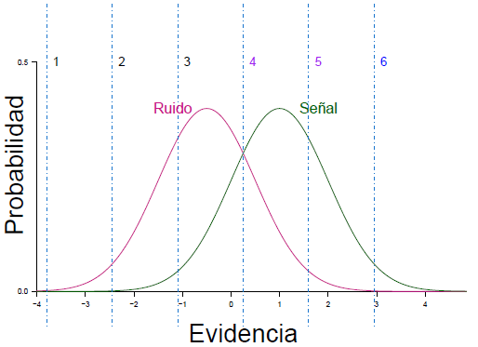
Confidence Scale task
1 | 2 | 3 | 4 | 5 | 6

Slide 10
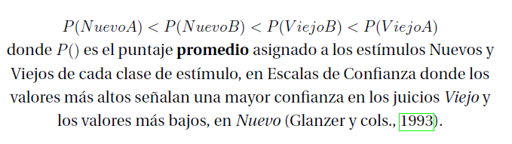
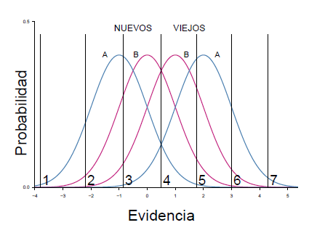
Confidence Scale task

Slide 11

Why is it important?
The fact that more Hits are observed than False Alarms, is mostly trivial, given that a signal is defined by having a greater value on the X axis than noise. Shouldn’t be surprising.

Slide 12
Why is it important?
The fact that more Hits are observed in the A class (“the easier condition”) than for B, is what we would expect to find under a SDT framework. It could be interpreted as a reflection of d’ differences, which we already know represent the discriminability of each class’ signal and the noisy stimuli.

Slide 13
Why is it important?
If you think of them as just a certain way of making a “mistake”, the difference found withing the False Alarms rates shouldn’t be surprising, either.
However, since we’re applying a SDT framework to the interpretation of these data, this difference implies that there are more than one single Noise distribution and that is something that SDT can’t explain.

Slide 14
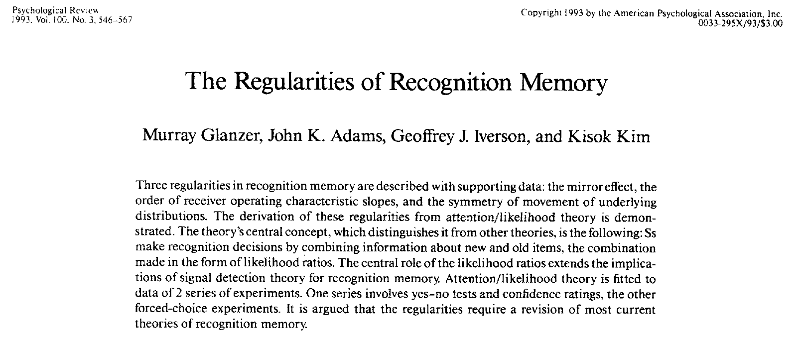

Slide 15
First idea:
Is the Mirror Effect a phenomenon exclusively related to Recognition Memory OR would we be able to find evidence of the Mirror Effect on another domain?

Slide 16
Method

Slide 17
Results 1.0
Did we replicate what has been reported in the literature?

Slide 18
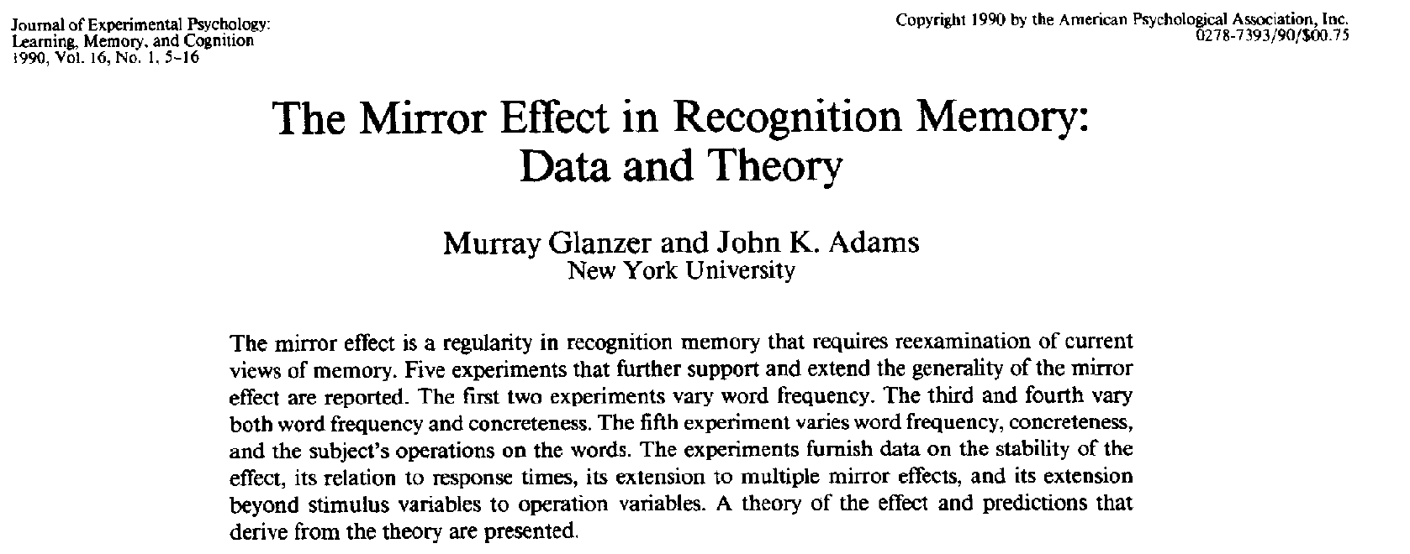
A) Replication of the analysis reported in the M.E. literature
Our replication was done step-by-step as reported in:
2.- Comparing the Hit and F.A. rates to test the M.E. pattern of response
Computing the Hit and F.A. rate per participant and do an arcsine transformation
3.- Comparing the Mean confidence ratings assigned to each class of stimuli.

Slide 19
A) Replication of the analysis reported in the M.E. literature
1.- Make sure that d’(A) > d’(B)
2.- Comparing the Hit and F.A. rates to test the M.E. pattern of response
3.- Comparing the Mean confidence ratings assigned to each class of stimuli.

Slide 20
A) Replication of the analysis reported in the M.E. literature
1.- Make sure that d’(A) > d’(B)
Calculate d’ for each class of stimuli, per participant
t-test!
2.- Comparing the Hit and F.A. rates to test the M.E. pattern of response
3.- Comparing the Mean confidence ratings assigned to each class of stimuli.

Slide 21
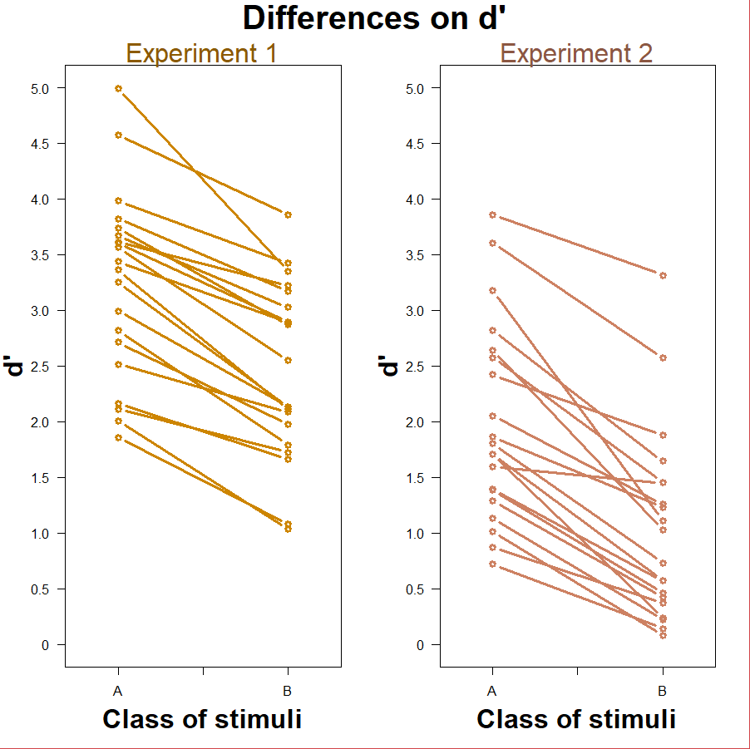
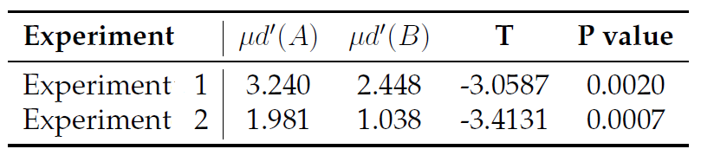

Slide 22
A) Replication of the analysis reported in the M.E. literature
1.- Make sure that d’(A) > d’(B)
2.- Comparing the Hit and F.A. rates to test the M.E. pattern of response
Compute the Hit and F.A. rates per participant and apply an arcsine transformation
Compare Hit rates and F.A. rates with two different t-tests!
3.- Comparing the Mean confidence ratings assigned to each class of stimuli.

Slide 23
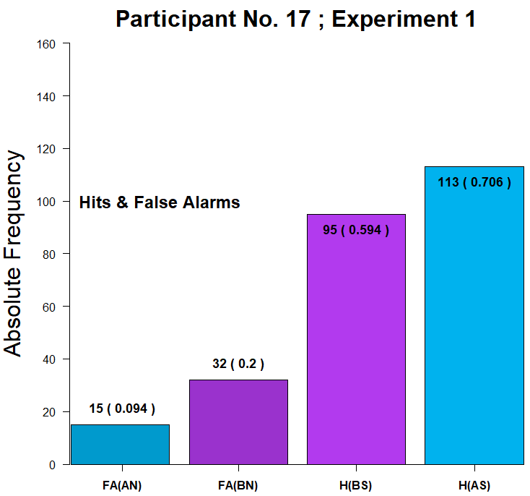
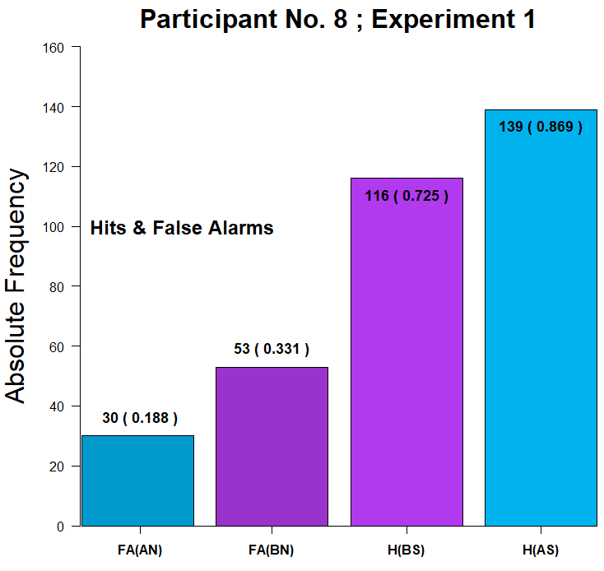
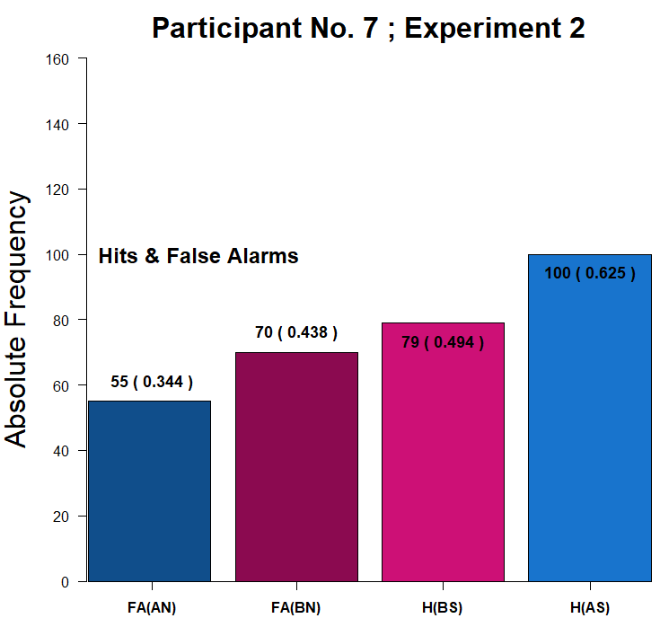
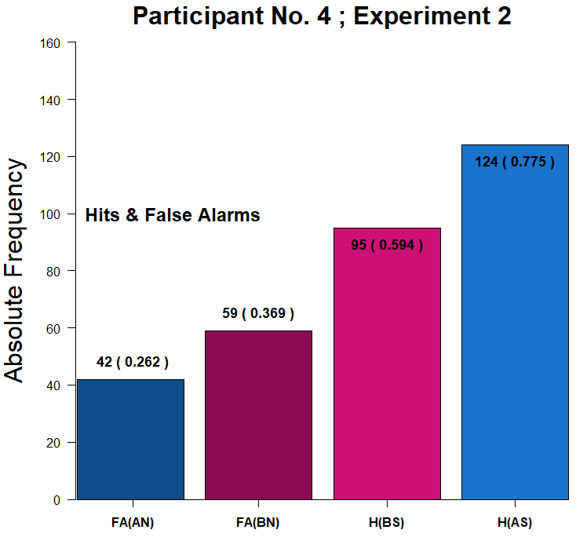
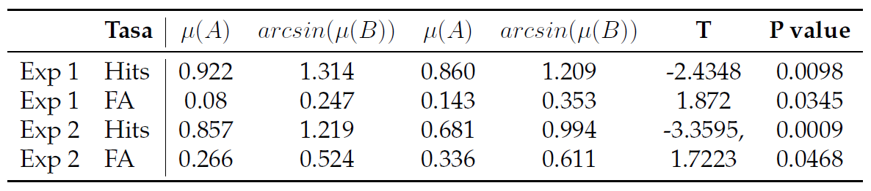
F(A) < F(B) < H(B) < H(A)

Slide 24
A) Replication of the analysis reported in the M.E. literature
1.- Make sure that d’(A) > d’(B)
2.- Comparing the Hit and F.A. rates to test the M.E. pattern of response
3.- Comparing the Mean confidence ratings assigned to each class of stimuli.

Slide 25
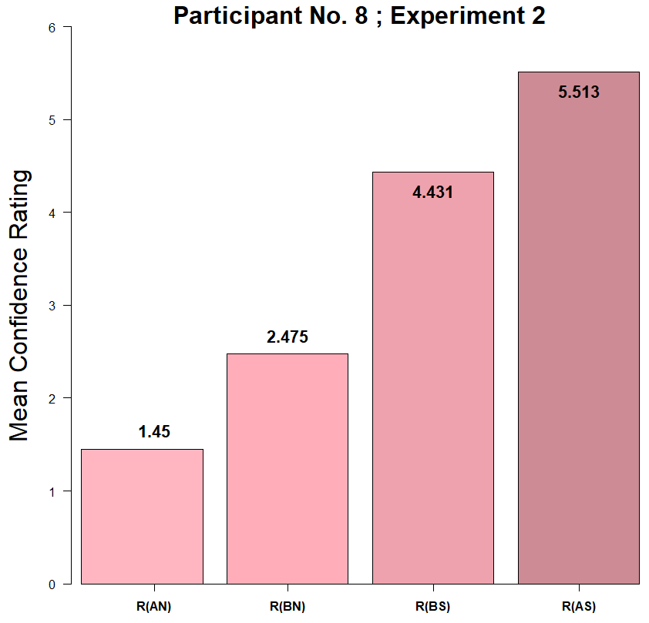
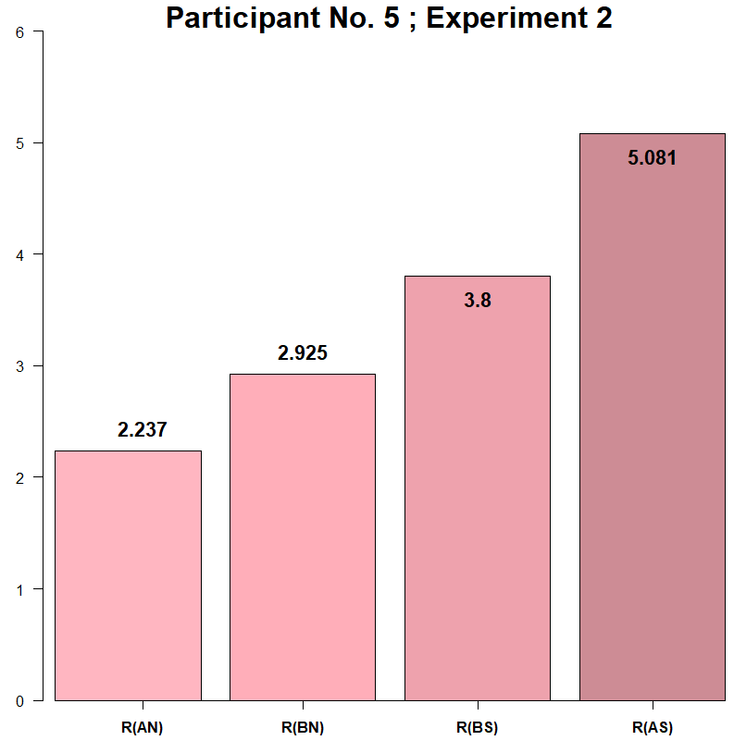
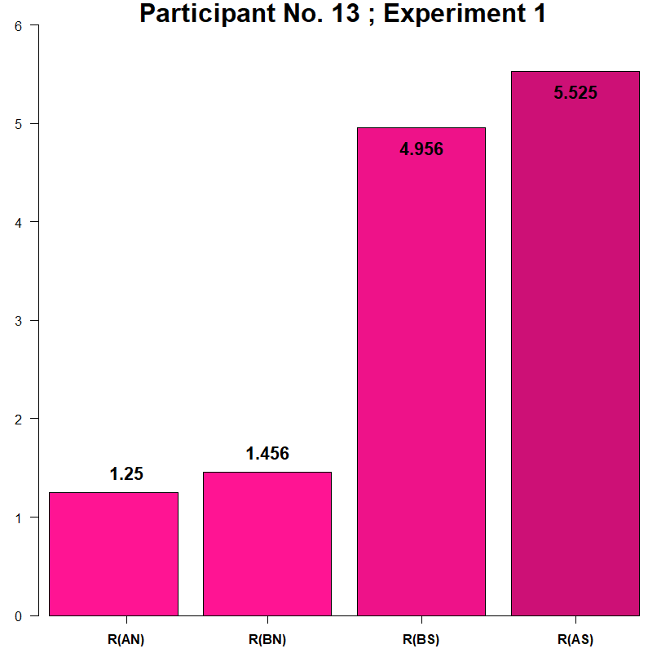
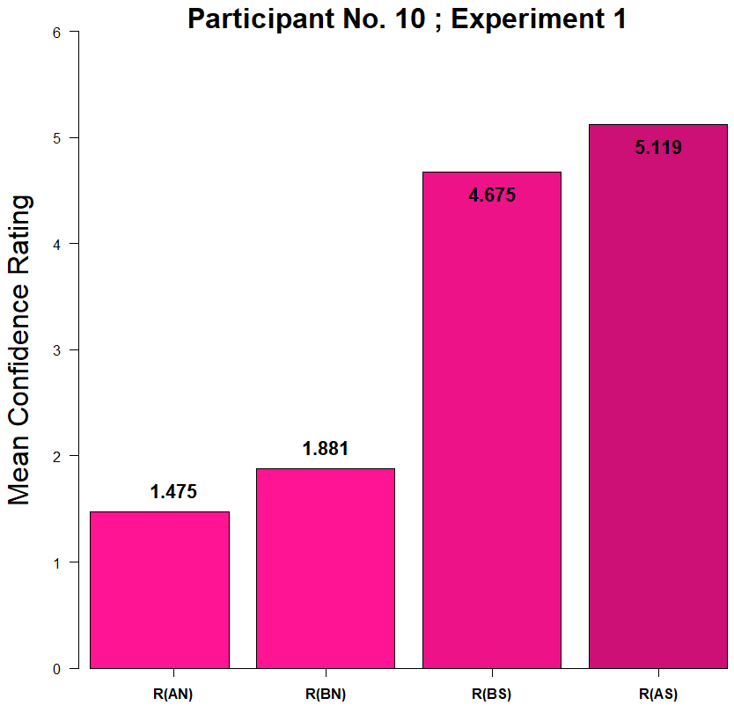
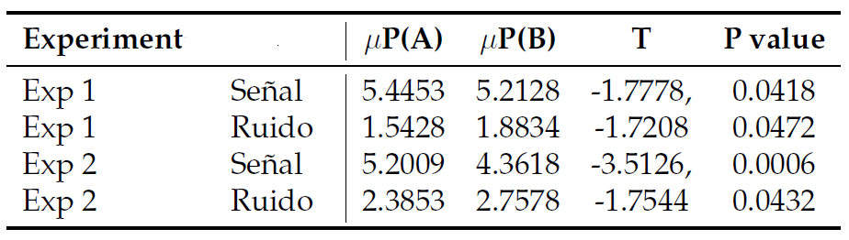
R(NoA) < R(NoB) < R(YesB) < R(YesA)

Slide 26
First conclusion:
Yes, we were able to find evidence for the Mirror Effect.

Slide 27
Second idea:
There are pretty reasonable reasons to think that the study of the Mirror Effect could benefit from the application of Bayesian methods to the assessment of statistical and cognitive model

Slide 28
Results 2.0
Bayesian statistical and cognitive modeling!

Slide 29
0. Contaminant Bayesian modeling
In order to make our results comparable to what has been reported on the literatura of the Mirror Effect withing Recognition Memory, we have to be able to guarantee that our two clases of stimuli are indeed different in terms of how “difficult” they are.

Slide 30
0.1 A “statistical” contaminant model
The experiment was programmed so that on each trial, participants could face a signal or noise trial from either class of stimuli completely at random.
Given the sturcture of the experiment, one would expect that “Yes” and “No” responses were registered with a fairly equal probability on each trial. We test this with a first mixture model for the plain “yes” “no” input registered by participants.

Slide 31
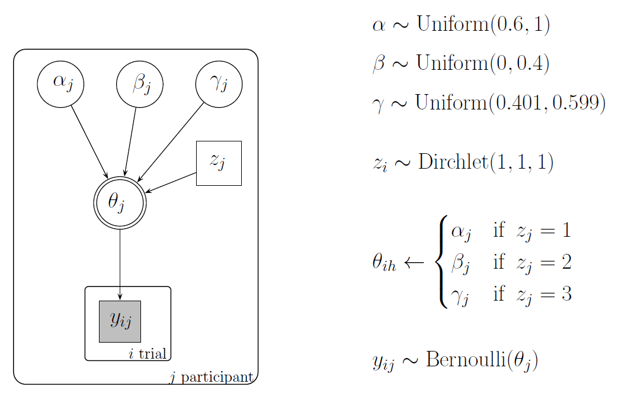

Slide 32
0.2 A “cognitive” contaminant model
A Mixture Model

Slide 33
1. Hierarchical SDT model applied to our data

Slide 34
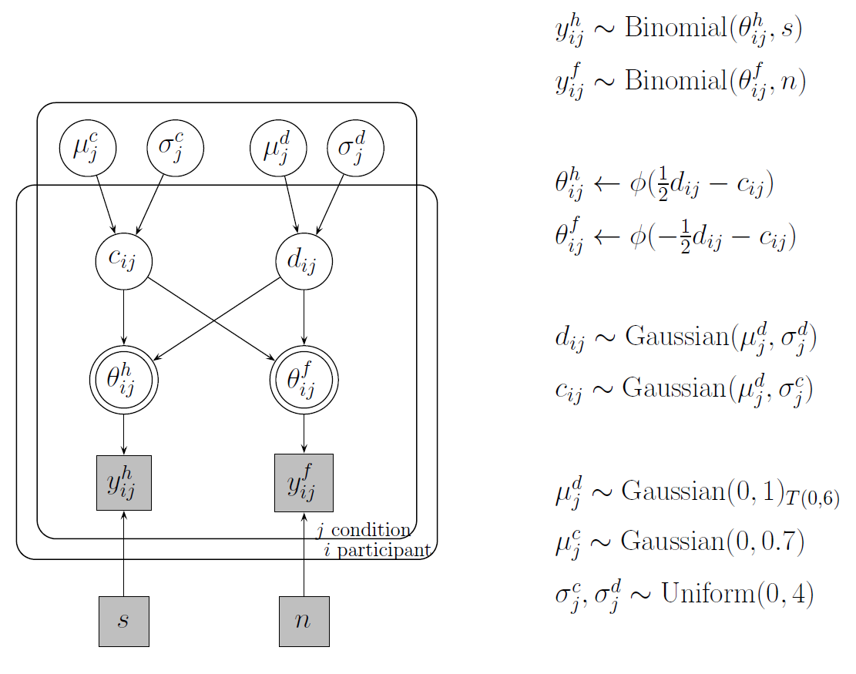
We apply a Hierarchical Bayesian SDT model

Slide 35
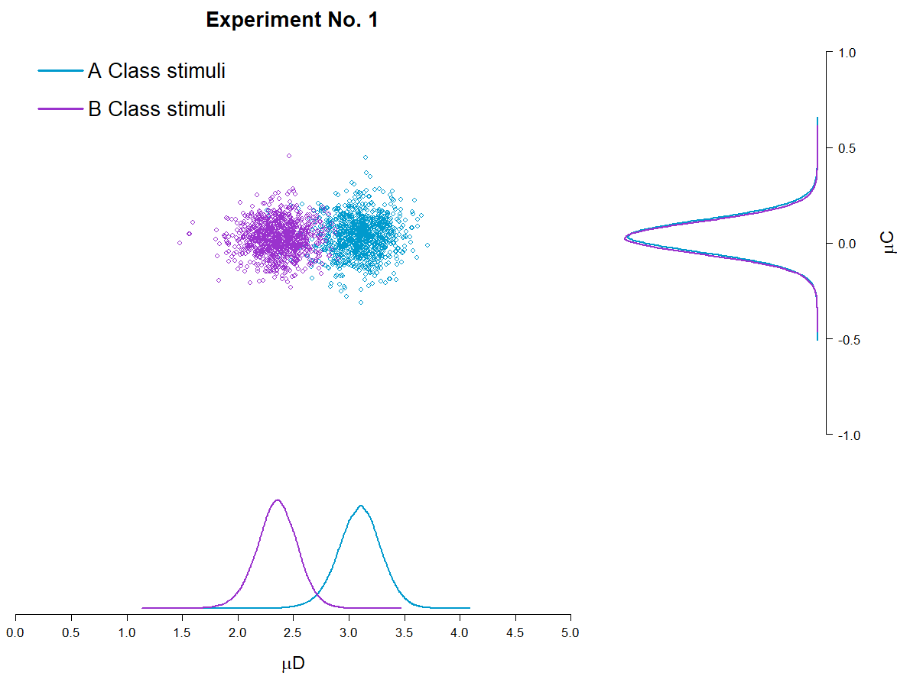
Plot 1
It is interesting to note that for Experiment No. 1, yes, some differences are found in terms of the mean d’ estimations for each class of stimuli, but this doesn’t happen for C, which according to the proposed hierarchical model could be described by the same mean value for both classes of stimuli.

Slide 36
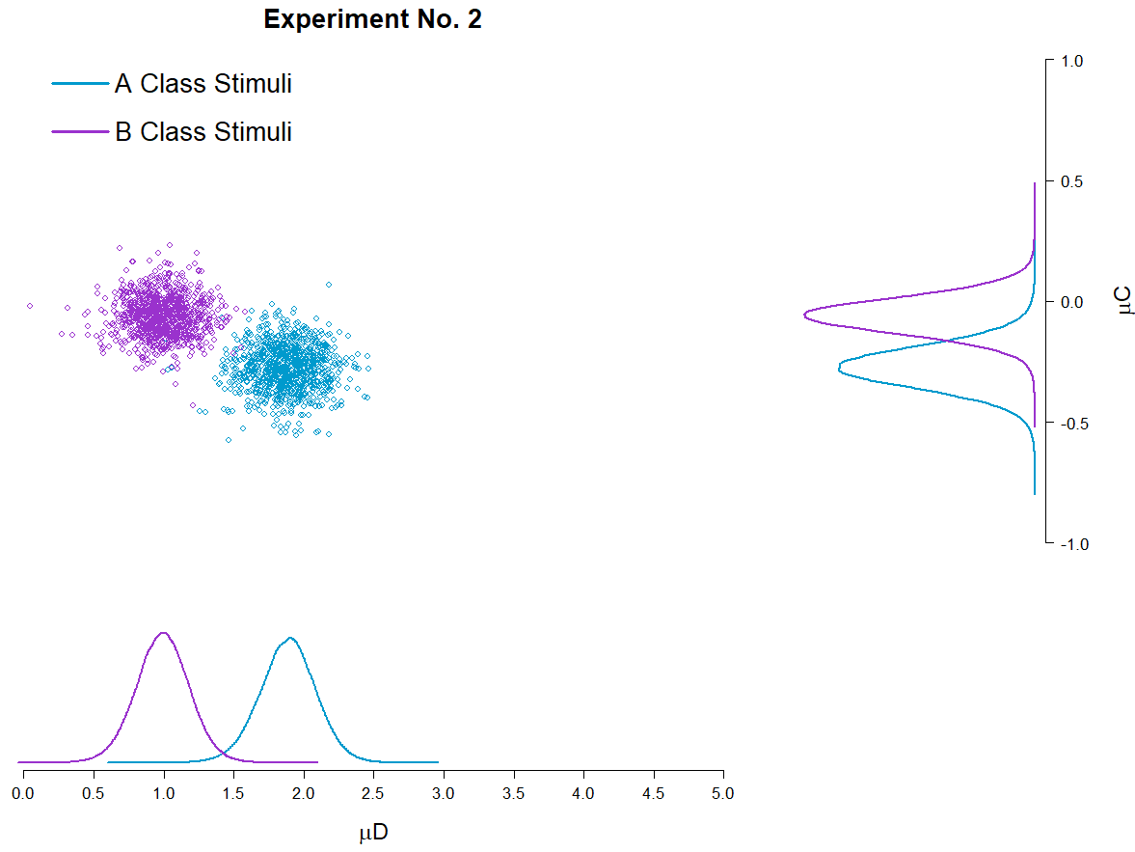
Plot 1
Even more interesting should be the fact that this doesn’t hold up for Experiment No. 2, where differences between classes of stimuli are observed both for d’ and C.

Slide 37
According to this article:

Slide 38
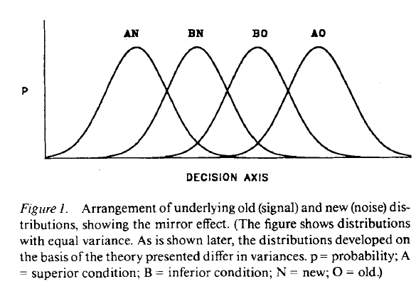
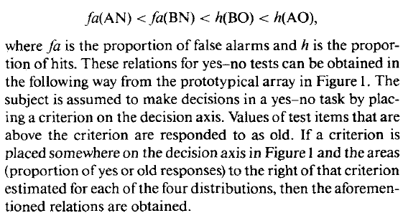
1) There’s a single criterion

Slide 39
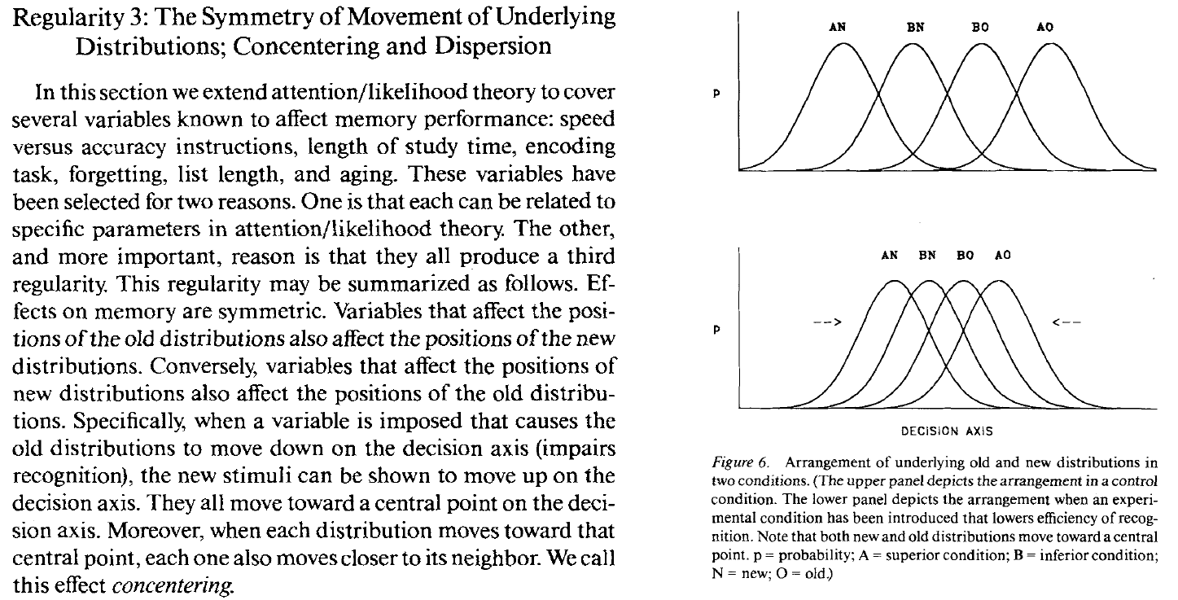
2)

Slide 40
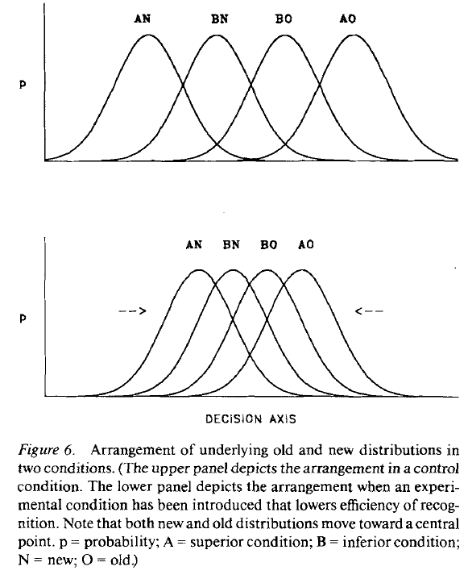
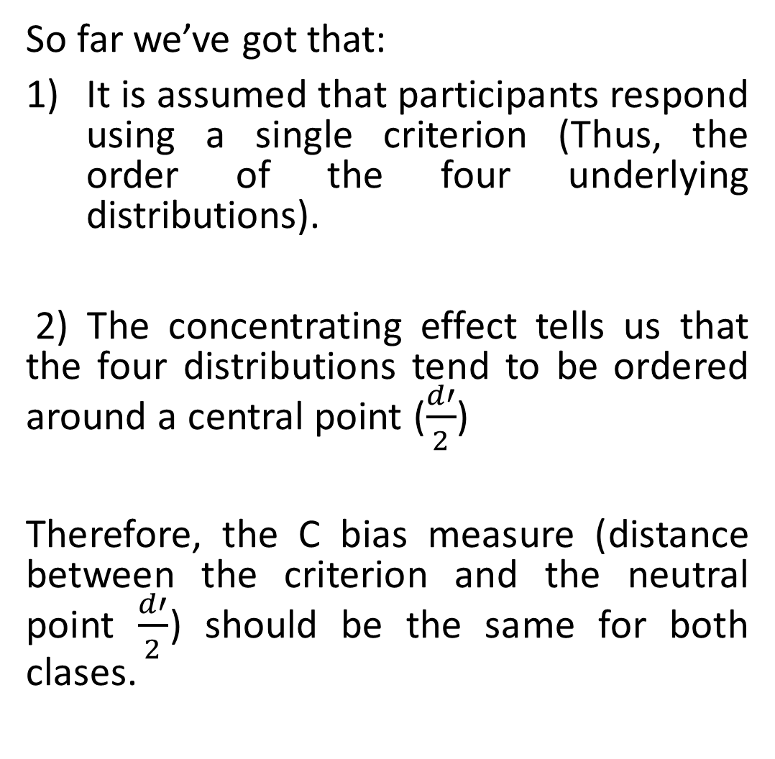
So far we’ve got that:
It is assumed that participants respond using a single criterion (Thus, the order of the four underlying distributions).
2) The concentrating effect tells us that the four distributions tend to be ordered around a central point ($\frac{d′}{2}$)
Therefore, the C bias measure (distance between the criterion and the neutral point $\frac{d′}{2}$) should be the same for both clases.

Slide 41
2. Making sure d’(A) > d’(B)
In order to make our results comparable to what has been reported on the literature of the Mirror Effect withing Recognition Memory, we have to be able to guarantee that our two clases of stimuli are indeed different in terms of how “difficult” they are.

Slide 42
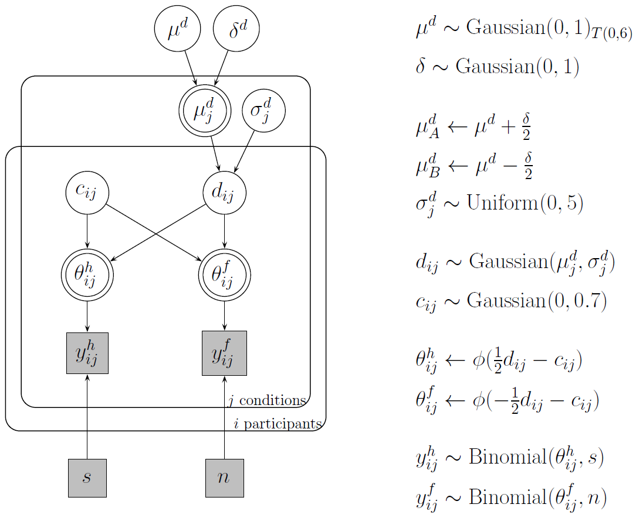

Slide 43
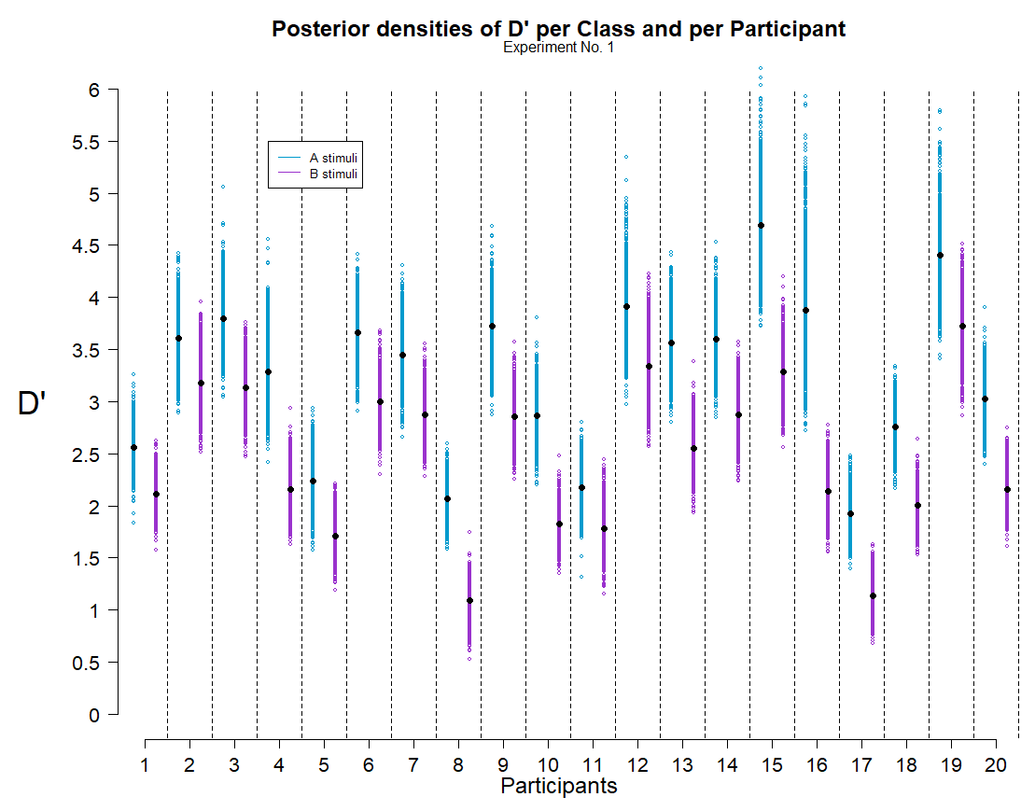
Plot 1
What’s important about this plot?
For all participants, D’ estimates are greater for A class than for B class.
Notes:
PS: Alex suggested me to use this kind of plot and I really liked it.

Slide 44
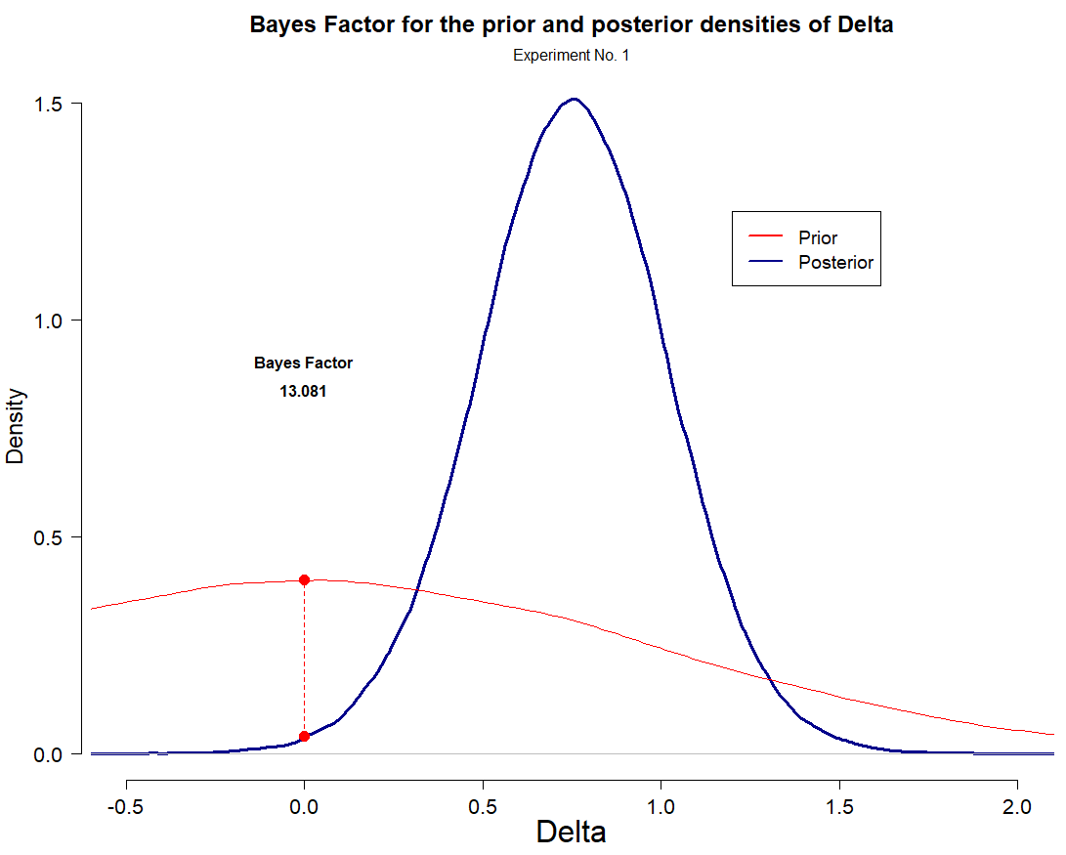
Plot 2
What’s important about this plot?
According to the Bayes Factor, the posterior estimates suggest that it’s 13 times lees likely that the difference between d’ across each class of stimuli is 0, than/from what had been stated on the prior.
Notes:
PS: Alex suggested me to use this kind of plot and I really liked it.

Slide 45
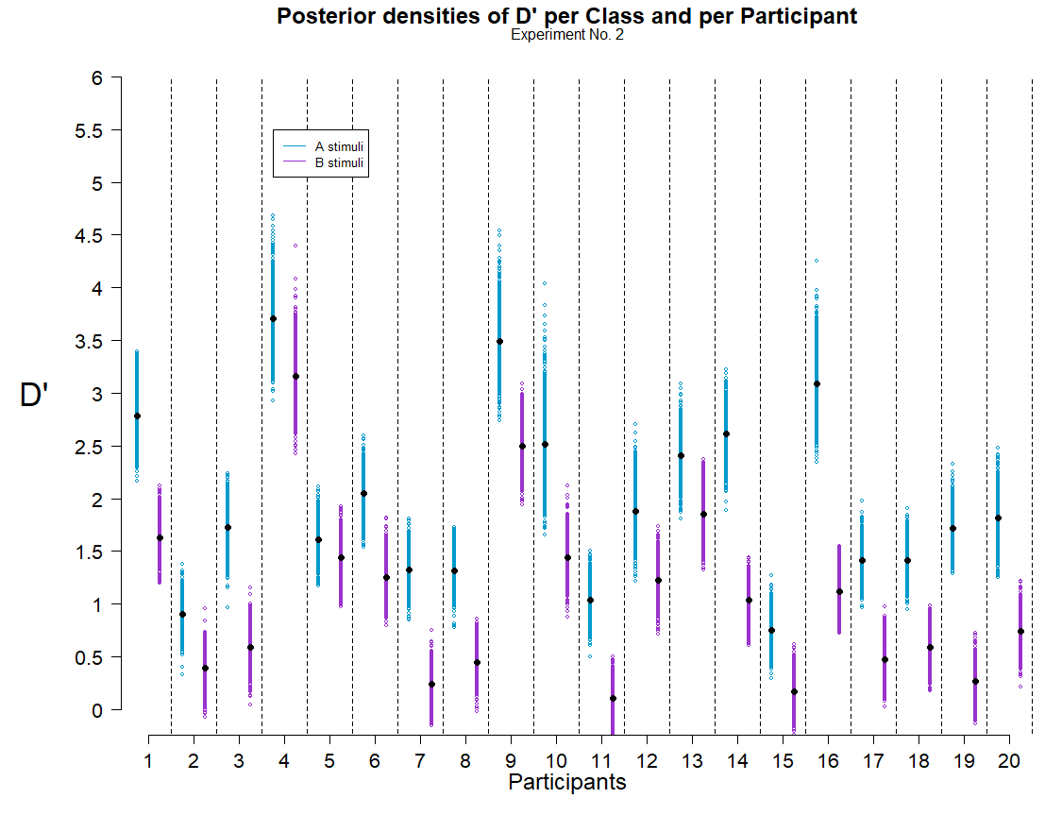
Plot 1
Same things happen in Experiment 2
For all participants, d’ estimates are greater for A class stimuli than for B class.
Notes:
PS: Alex suggested me to use this kind of plot and I really liked it.

Slide 46
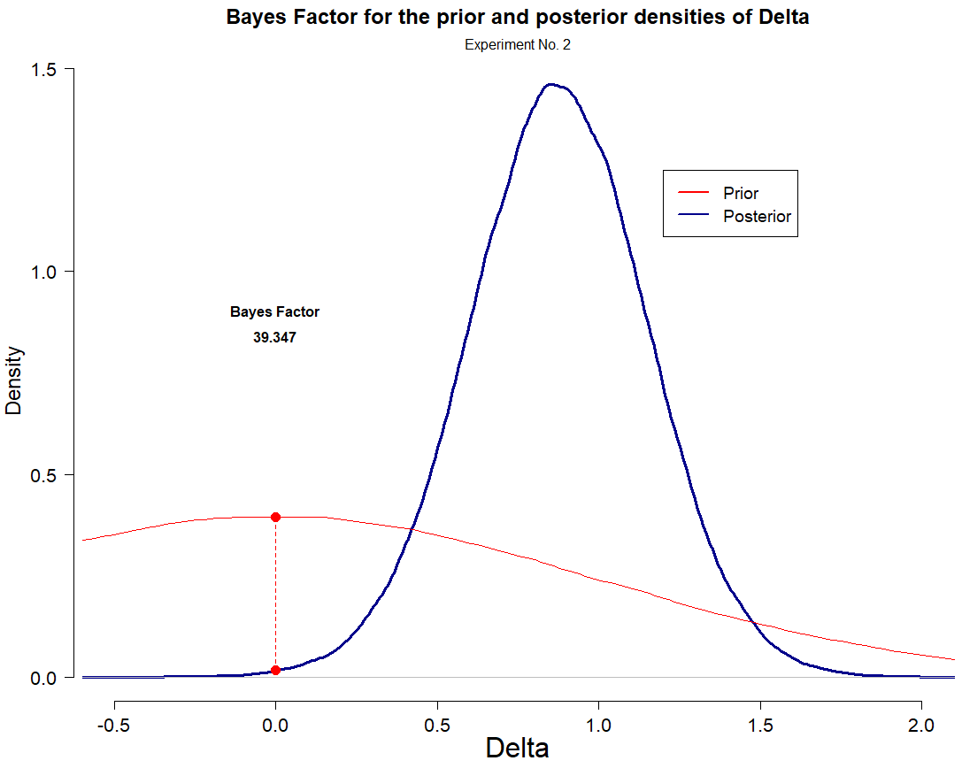
Plot 2
According to the Bayes Factor, the posterior estimates suggest that it’s 41.5 times lees likely that the difference between d’ across each class of stimuli is 0, than/from what had been stated on the prior.

Slide 47
3. Looking for the Mirror Effect
Comparing the Hit and F.A. rates across clases of stimuli to see if we can find the same pattern as the one reported in the literatura under the name of “the Mirror Effect”
FA(A) < FA(B) < H(B) < H(A)

Slide 48
3.1 Comparing binomial response rates

Slide 49
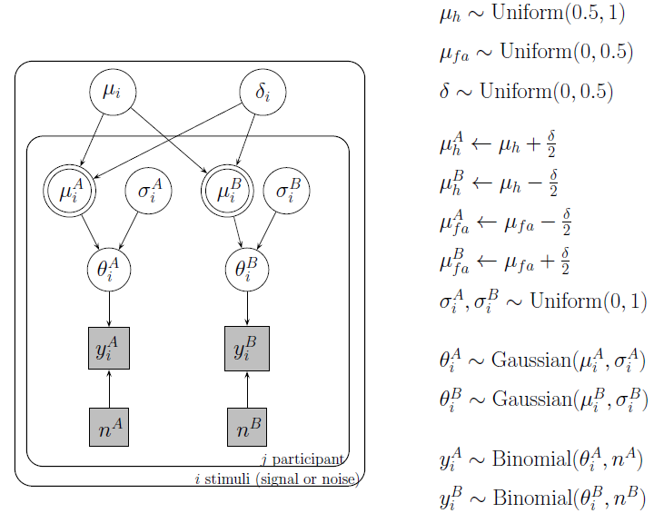

Slide 50
3.2 Comparing Hit rates and F.A. rates in the context of a Bayesian cognitive model
Using a Bayesian cognitive SDT model to look through the differences observed between the Hit and F.A. rates across clases of stimuli

Slide 51
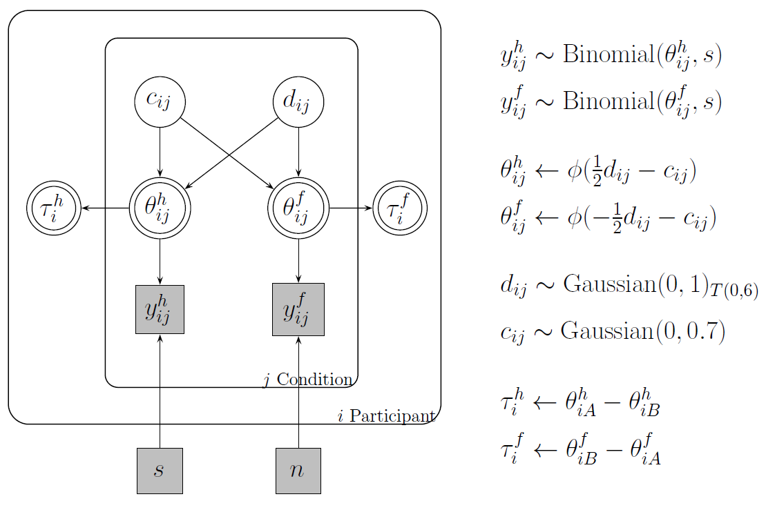

Slide 52
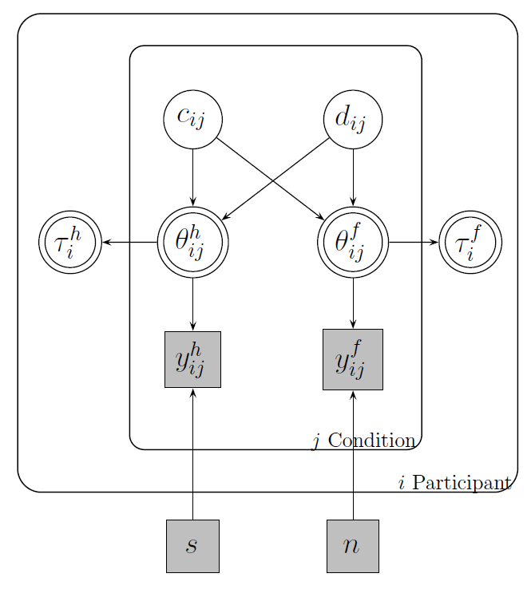
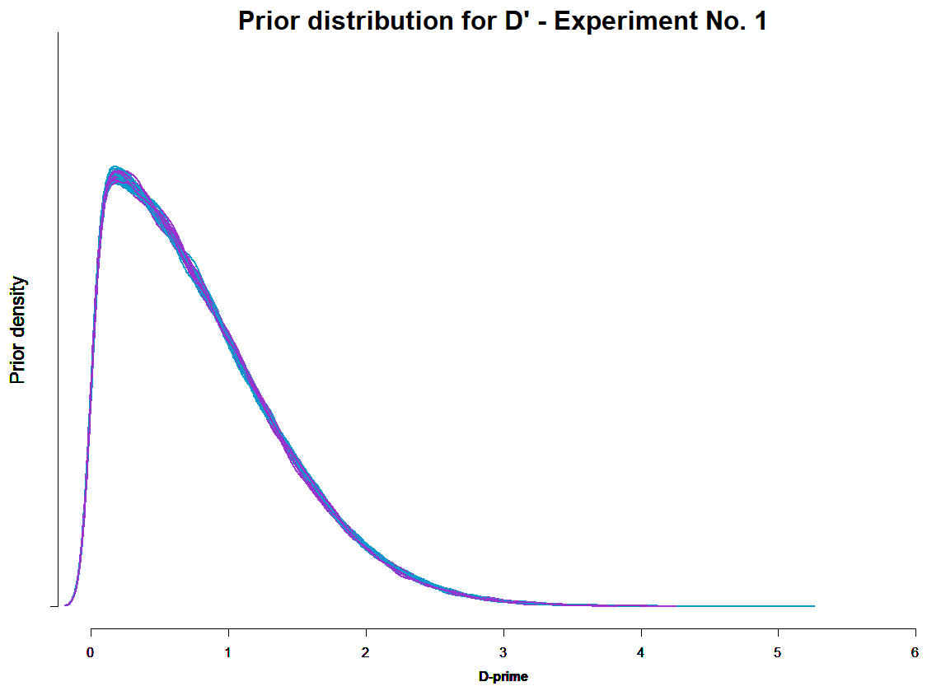
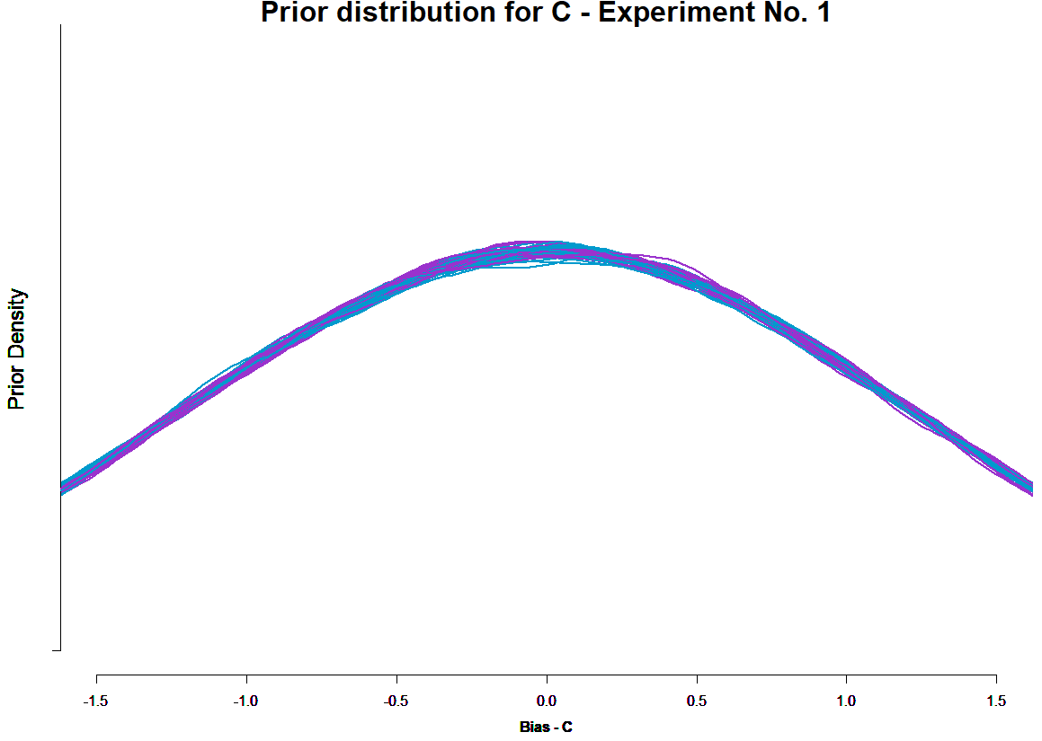

Slide 53
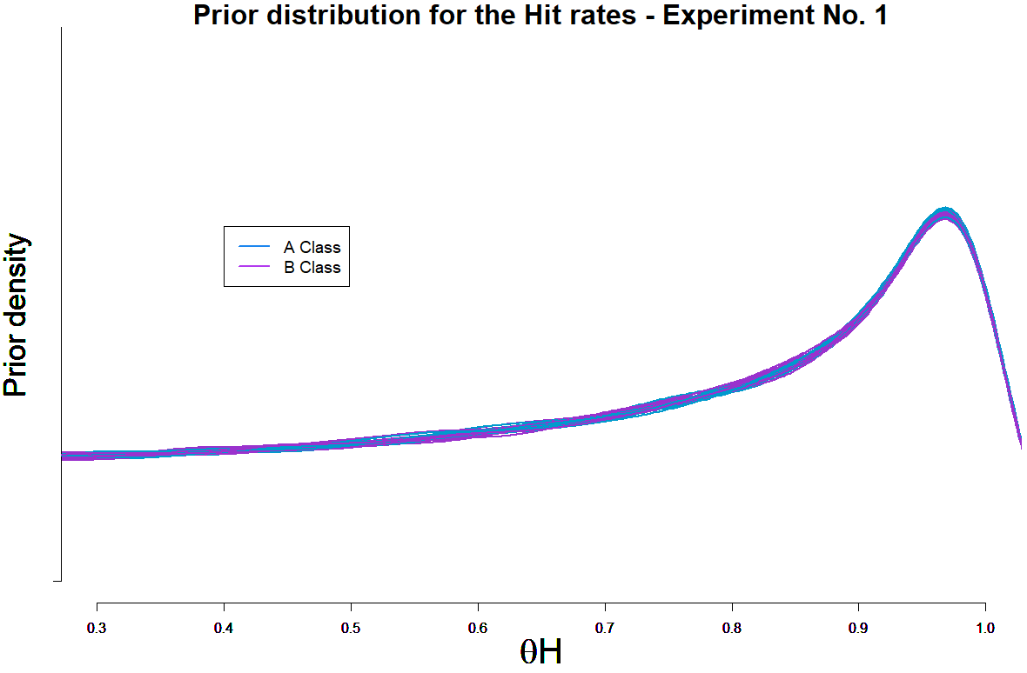
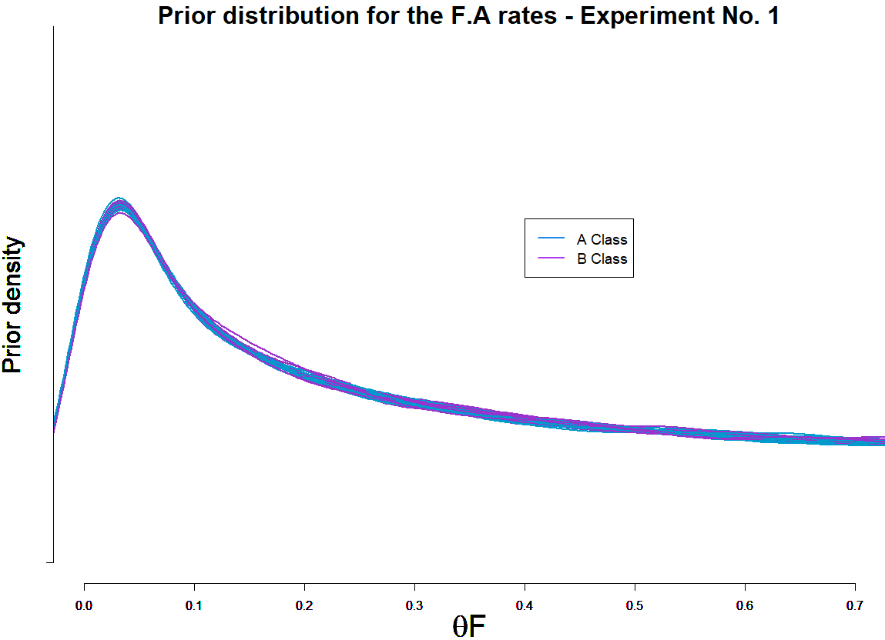

Slide 54
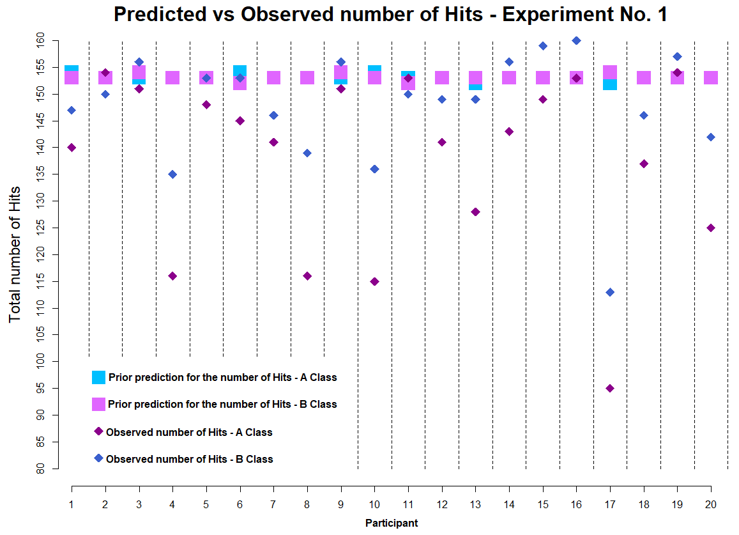
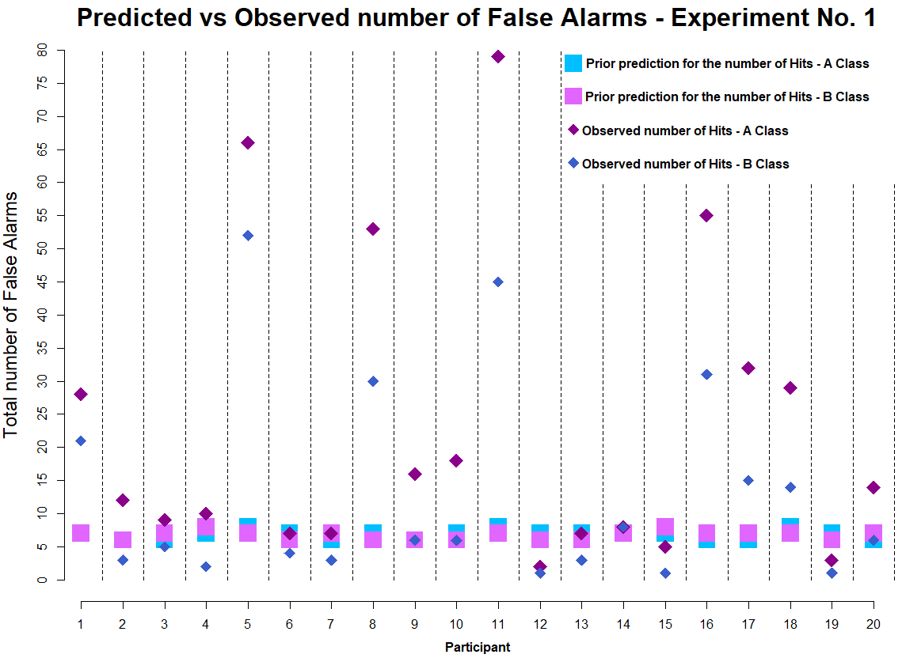
EXPERIMENT 1

Slide 55
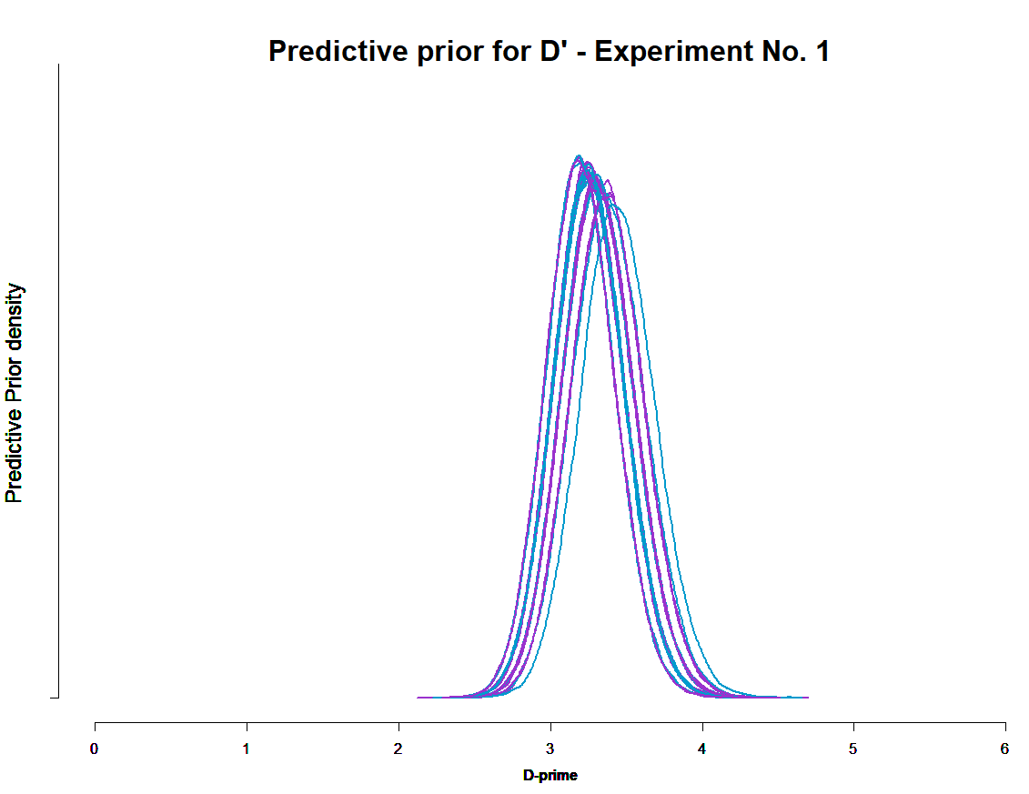
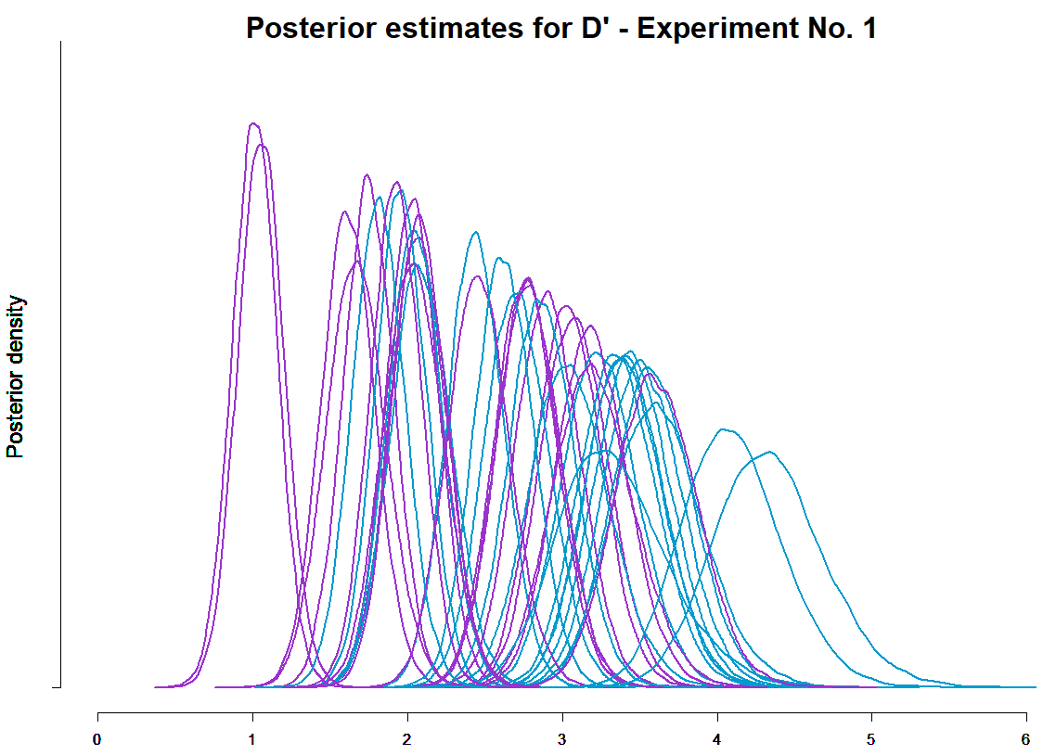
EXPERIMENT 1

Slide 56
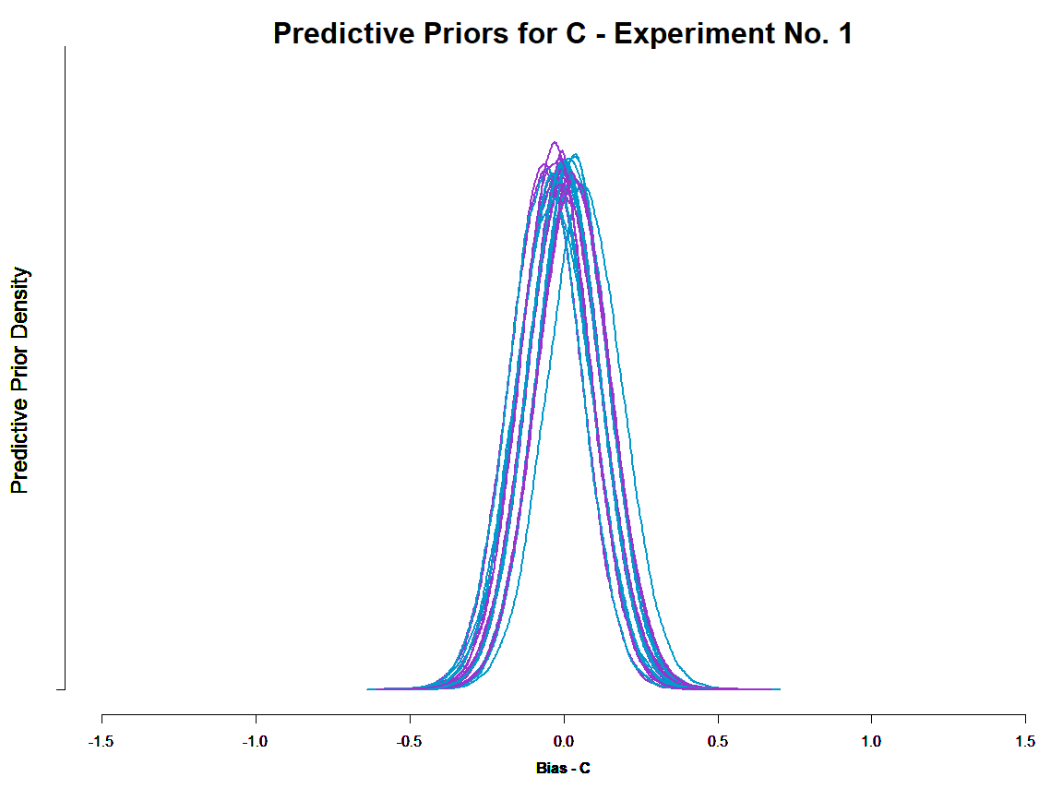
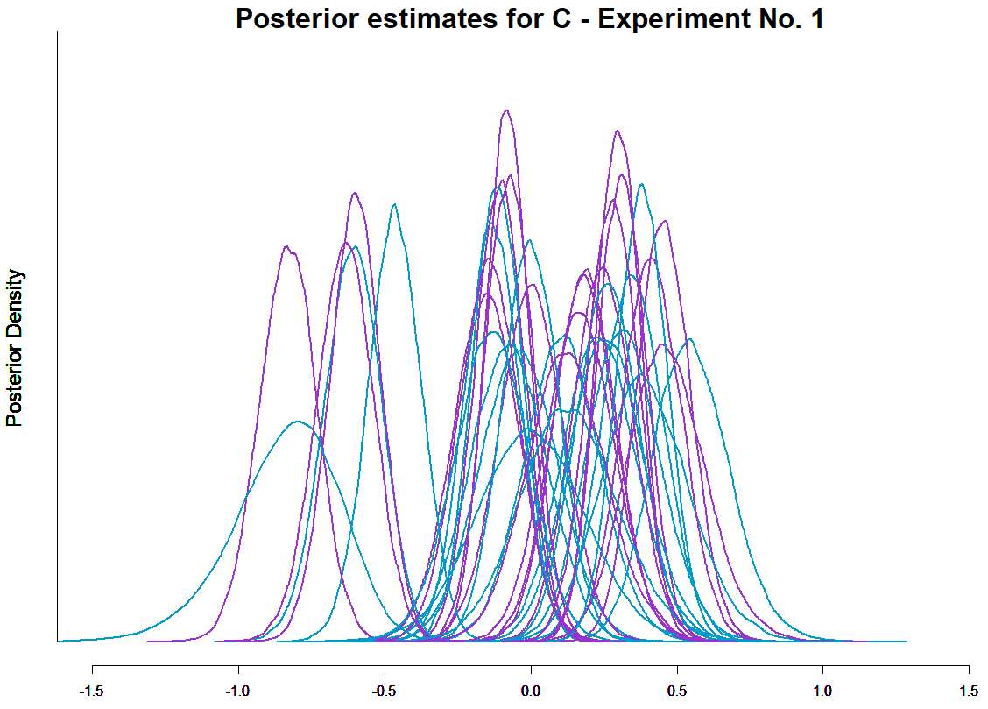
EXPERIMENT 1

Slide 57
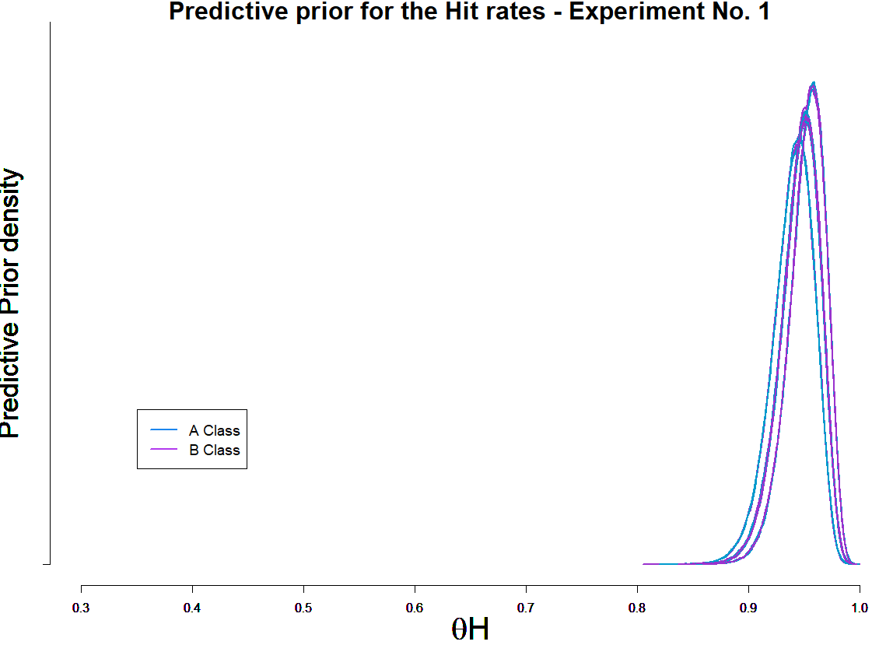
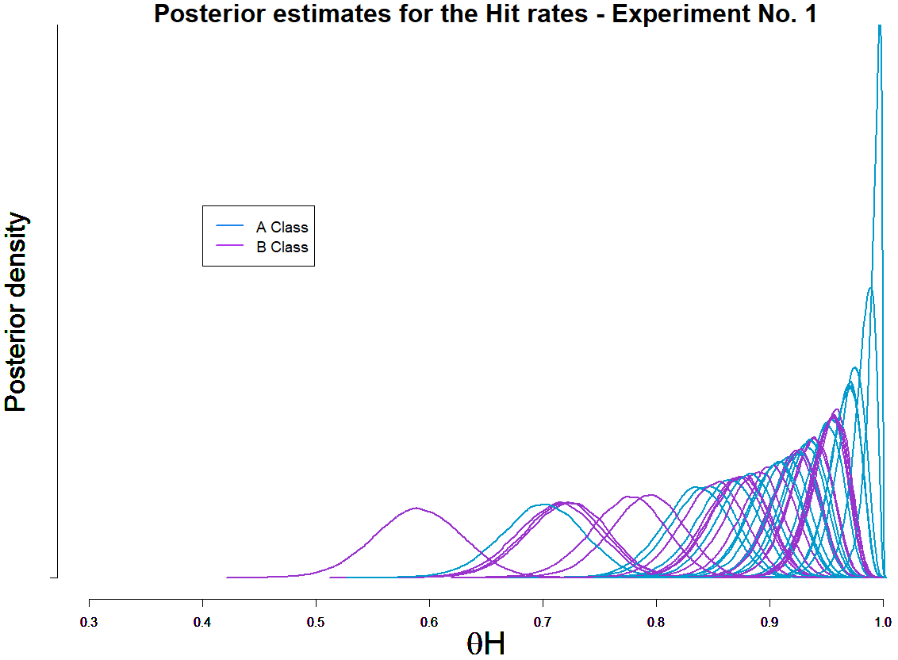
EXPERIMENT 1

Slide 58


EXPERIMENT 1

Slide 59


EXPERIMENT 1
Prior Predictive
Posterior Densities

Slide 60


EXPERIMENT 2

Slide 61


EXPERIMENT 2

Slide 62


EXPERIMENT 2

Slide 63


EXPERIMENT 2

Slide 64


EXPERIMENT 2

Slide 65


EXPERIMENT 2
Prior Predictive
Posterior Densities

Slide 66


EXPERIMENT 2

Slide 67

EXPERIMENT 2

Slide 68

EXPERIMENT 2

Slide 69
EXPERIMENT 2

Slide 70


Slide 75
4. Step change point modeling
PENDING
Do participants face changes in D’ or C across trials?

Slide 76
5. Testing an Unequal Variance Model
PENDING
What can be inferred from the Confidence rating data?

Slide 77
5.1 Are participants using all of the Confidence Ratings ?
PENDING

